Slide 1
AVL Trees
Presentation for use with the textbook Data Structures and Algorithms in Java, 6th edition, by M. T. Goodrich, R. Tamassia, and M. H. Goldwasser, Wiley, 2014
6
v
3
8
z
4

Slide 2
AVL Tree Definition
AVL trees are balanced
An AVL Tree is a binary search tree such that for every internal node v of T, the heights of the children of v can differ by at most 1
An example of an AVL tree where the heights are shown next to the nodes

Slide 3
Height of an AVL Tree
n(2)
3
4
n(1)
Fact: The height of an AVL tree storing n keys is O(log n).
Proof (by induction): Let us bound n(h): the minimum number of internal nodes of an AVL tree of height h.
We easily see that n(1) = 1 and n(2) = 2
For n > 2, an AVL tree of height h contains the root node, one AVL subtree of height n-1 and another of height n-2.
That is, n(h) = 1 + n(h-1) + n(h-2)
Knowing n(h-1) > n(h-2), we get n(h) > 2n(h-2). So
n(h) > 2n(h-2), n(h) > 4n(h-4), n(h) > 8n(n-6), … (by induction),
n(h) > 2^{i}n(h-2i)
Solving the base case we get: n(h) > 2 ^{h/2-1}
Taking logarithms: h < 2log n(h) +2
Thus the height of an AVL tree is O(log n)

Slide 4
Insertion
Insertion is as in a binary search tree
Always done by expanding an external node.
Example:
44
44
17
78
17
78
c=z
a=y
32
50
88
32
50
88
48
62
48
62
b=x
54
before insertion
w
after insertion

Slide 5
After Insertion
All nodes along the path increase their height by 1.
It may violate the AVL property.
44
4
44
5
17
78
3
17
78
c=z
a=y
4
32
50
2
88
32
50
3
88
48
62
48
62
1
b=x
2
54
w
1
before insertion
after insertion

Slide 6
Search and Repair
Let z be the first violation node along the path.
Let y be z’child with the higher height (y is 2 greater than its sibling).
Let x be y’s child with the higher height.
We rebalance z by calling trinode restructuring method.

Slide 7
Search and Repair
Let y be z’child with the higher height (y is 2 greater than its sibling).
Let x be y’s child with the higher height.
We rebalance z by calling trinode restructuring method.

Slide 8
Search and Repair
Rebalance the tree by performing appropriate rotations on the subtree rooted with z. There can be 4 possible cases that needs to be handled as x, y and z can be arranged in 4 ways. Following are the possible 4 arrangements:
a) y is left child of z and x is left child of y (Left Left Case) b) y is left child of z and x is right child of y (Left Right) c) y is right child of z and x is right child of y (Right Right) d) y is right child of z and x is left child of y (Right Left)

Slide 9
Trinode Restructuring
Let (a,b,c) be the inorder listing of x, y, z
Perform the rotations needed to make b the topmost node of the three
Double rotation about c and a (right rotate c and then left rotate a)
(other two cases are symmetrical)
a=z
a=z
b=y
T₀
c=y
T₀
c=x
b=x
T₃
T₁
b=y
b=x
T₂
T₃
T₁
T₂
a=z
c=x
a=z
c=y
Single rotation about a (left rotate a)
T₀
T₁
T₂
T₃
T₀
T₁
T₂
T₃

Slide 10
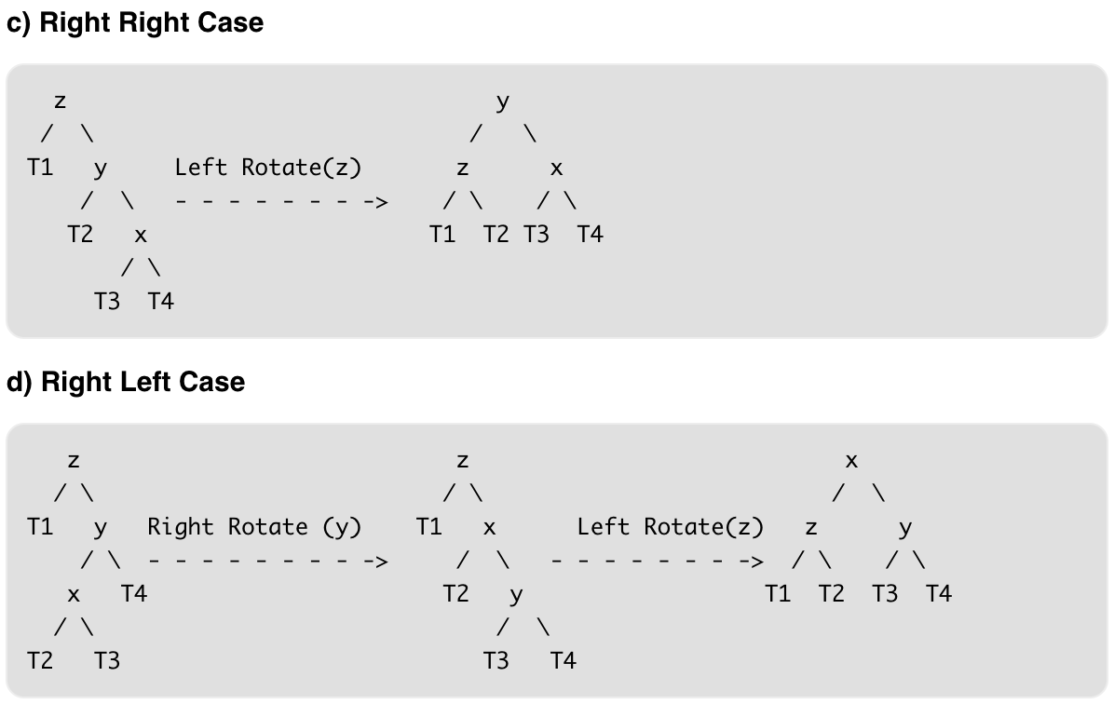
Trinode Restructuring

Slide 11
Restructuring (as Single Rotations)
Single Rotations:

Slide 12
Restructuring (as Double Rotations)
double rotations:

Slide 13
Insertion Example, continued
unbalanced...
T
4
1
44
2
3
x
17
y
62
z
1
2
2
32
50
78
1
1
1
...balanced
48
54
88
T
2
T
T
T
0
1
3

Slide 14
Removal
Removal begins as in a binary search tree, which means the node removed will become an empty external node. Its parent, w, may cause an imbalance.
Example:
44
44
17
62
17
62
32
50
78
50
78
48
54
88
48
54
88
before deletion of 32
after deletion

Slide 15
Rebalancing after a Removal
Let z be the first unbalanced node encountered while travelling up the tree from w. Also, let y be the child of z with the larger height, and let x be the child of y with the larger height
We perform a trinode restructuring to restore balance at z
As this restructuring may upset the balance of another node higher in the tree, we must continue checking for balance until the root of T is reached
a=z
62
44
w
b=y
44
78
17
62
c=x
17
50
88
50
78
48
54
48
54
88

Slide 16
AVL Tree Performance
AVL tree storing n items
The data structure uses O(n) space
A single restructuring takes O(1) time
using a linked-structure binary tree
Searching takes O(log n) time
height of tree is O(log n), no restructures needed
Insertion takes O(log n) time
initial find is O(log n)
restructuring up the tree, maintaining heights is O(log n)
Removal takes O(log n) time
initial find is O(log n)
restructuring up the tree, maintaining heights is O(log n)

